Slide 1
Software Engineering
Sobia Iftikhar
Sobia.Iftikhar@nu.edu.pk
week 01

Slide 2
Grading Scheme
Mid-1and 2: 30 each
Assignment: 10
Project: 10
Final: 50

Slide 3
Referred Books
Software Engineering by Ian Sommerville (10 edition)
Software Engineering Practitioner’s Approach by Roger S. Pressman (Seventh Edition)

Slide 4
Content
Software
Software Crisis
Software Engineering
Need of SE
Factors of Software Failure
Professional Software Development,
Kinds of Software Products,
generic software product development v/s custom
Software Application Domains(pressmen),
Key phrases of SE,
Essential attributes of good software

Slide 5
Class 01 8-feb-2021

Slide 6
What is Software?
The product that software professionals build and then support over the long term.
Software encompasses:
(1) instructions (computer programs) that when executed provide desired features, function, and performance;
(2) data structures that enable the programs to adequately store and manipulate information
(3) documentation that describes the operation and use of the programs.

Slide 7
Software Crisis
Software Crisis is a difficulty of writing useful and efficient computer programs in the required time .
software crisis was due to using same workforce, same methods, same tools even though rapidly increasing in software demand, complexity of software and software challenges.
With increase in the complexity of software, many software problems arise because existing methods were insufficient.
. This condition is called software crisis.

Slide 8



Software Crisis cont’d
Normal Process
What if demand is increase with all same
Limitation. Then what if?
Software Crisis

Slide 9
Software Crisis cont’d
If we will use same workforce, same methods and same tools after fast increasing in software demand, software complexity and software challenges, then there arise some problems like software budget problem, software efficiency problem, software quality problem, software managing and delivering problem etc.
Increasing Demand
Software Crisis
Same
Workforce
Same Resources

Slide 10
Software Crisis Solution
Solution was to the problem was transforming unorganized coding effort into a software engineering discipline.
These engineering models helped companies to streamline operations and deliver software meeting customer requirements.

Slide 11
Why Software is Important?
The economies of ALL developed nations are dependent on software.
More and more systems are software controlled ( transportation, medical, telecommunications, military, industrial, entertainment,)
Software engineering is concerned with theories, methods and tools for professional software development.
Expenditure on software represents a significant fraction of GNP in all developed countries.

Slide 12
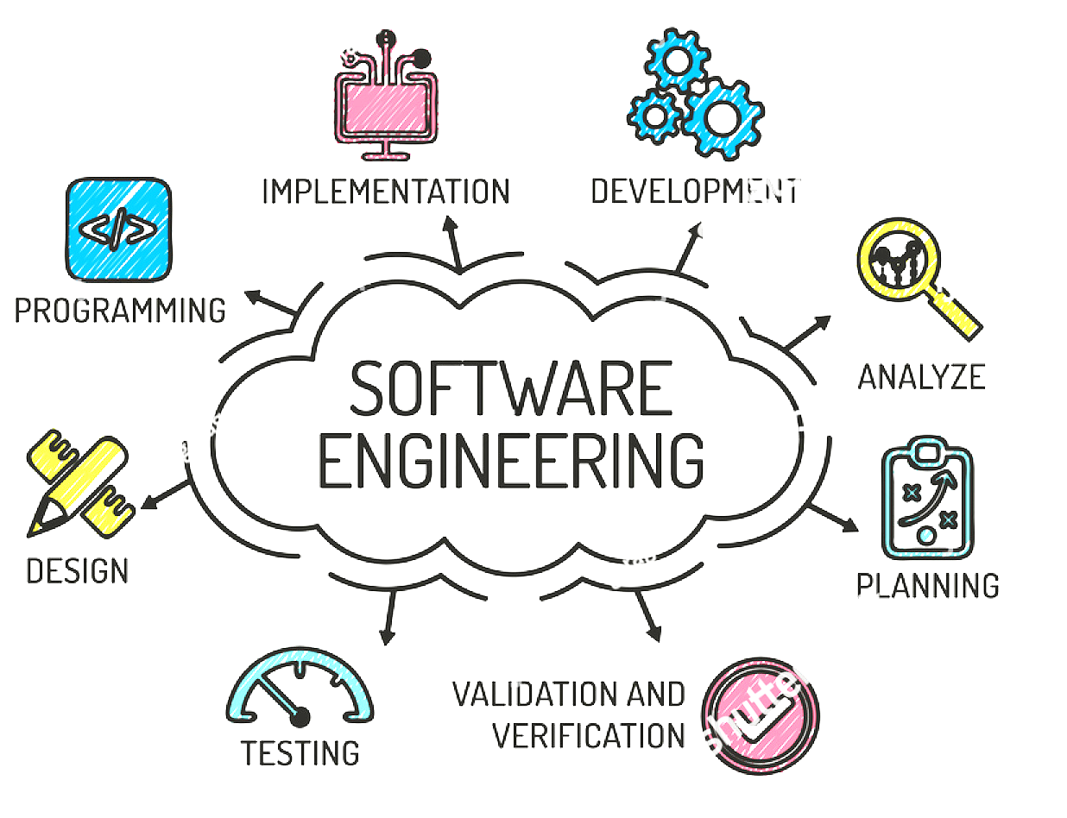
What is Software Engineering
Software engineering is defined as a process of analyzing user requirements and then designing, building, and testing software application which will satisfy those requirements.

Slide 13

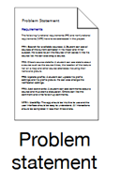

Need of SE
Product
User
UML
Development
Testing

Slide 14
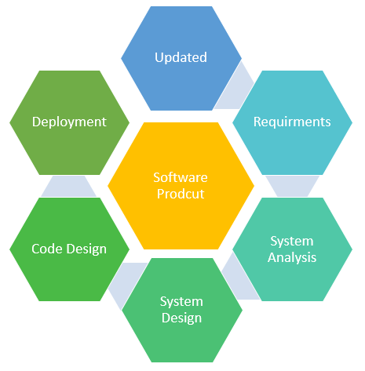
Why Software Engineering is Popular?
Large software – In our real life, it is quite more comfortable to build a wall than a house or building. In the same manner, as the size of the software becomes large, software engineering helps you to build software.
Scalability- If the software development process were based on scientific and engineering concepts, it is easier to re-create new software to scale an existing one.

Slide 15
Why Software Engineering is Popular?
Adaptability: Whenever the software process was based on scientific and engineering, it is easy to re-create new software with the help of software engineering.
Cost- Hardware industry has shown its skills and huge manufacturing has lower the cost of the computer and electronic hardware.
Dynamic Nature- Always growing and adapting nature of the software. It depends on the environment in which the user works.
Quality Management: Offers better method of software development to provide quality software products.

Slide 16
Software Failure?
Every software failure indicates an error in design or in the process through which design was translated into machine executable code.
System software may fail because of mistakes in its specification, design, or implementation.

Slide 17
Key Points of Software Failure?
Not Enough Time. ...
Insufficient Budget. ...
Poor Communication. ...
Never Reviewing Project Progress. ...
Inadequate Testing. ...
Testing in the Production Environment. ...
Lack of Quality Assurance. ...
Not Conforming to Industry Standards.

Slide 18
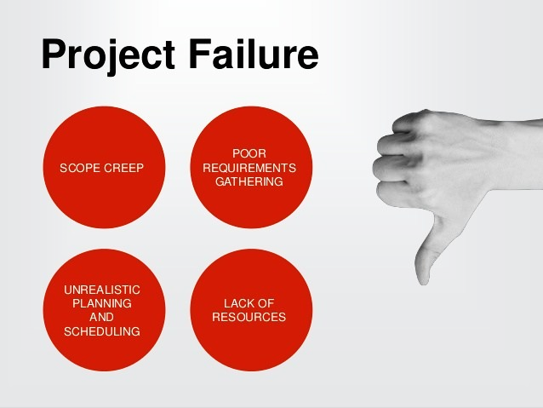
Factors of Software Failure
Increasing system complexity.
Failure to use software engineering

Slide 19
Factors of Software Failure
Increasing system complexity
As new software engineering techniques help us to build larger, more complex systems, the demands change. Systems have to be built and delivered more quickly; larger, even more complex systems are required; and systems have to have new capabilities that were previously thought to be impossible. New software engineering techniques have to be developed to meet new the challenges of delivering more complex software

Slide 20
Factors of Software Failure
2. Failure to use software engineering methods
It is fairly easy to write computer programs without using software engineering methods and techniques. Many companies have drifted into software development as their products and services have evolved. They do not use software engineering methods in their everyday work. Consequently, their software is often more expensive and less reliable than it should be. We need better software engineering education and training to address this problem.

Slide 21
Class 02 10-feb-2021

Slide 22
Activity
Imagine waking up one day, checking your mailbox an receiving a letter from your hospital saying you died. Well, that is precisely what happened to 8500 people who received treatment between Oct 25 and Dec 11 at St. Mary’s Mercy Hospital. So what happened? It turns out the hospital had recently upgraded its patient-management software system. However, a mapping error in the software resulted in the system assigning a code of 20 (which means “expired”) instead of 01 which meant the patient had been discharged. But that is not all. The erroneous data was not only sent to the patients but also to insurance companies and the local Social Security Office.
Immature Engineering
Software Failure
Low Quality Management

Slide 23
Professional Software Development
Software engineering is intended to support professional software development rather than individual programming.
It includes techniques that support program specification, design, and evolution, none of which are normally relevant for personal software development.
software is not just the programs themselves but also all associated
Documentation
Libraries
support websites, and configuration data that are needed to make these programs useful.

Slide 24
Professional Software Development
A professionally developed software system is often more than a single program.
A system may consist of several separate programs and configuration files that are used to set up these programs.
It may include system documentation, which describes the structure of the system, user documentation.
which explains how to use the system, and websites for users to download recent product information.

Slide 25



Why Professional Development is important
Reuse-code
Reuse-code
Reuse-code

Slide 26
Why Professional Development is important
This is one of the important differences between professional and amateur software development. If you are writing a program for yourself, no one else will use it.
and you don’t have to worry about writing program guides, documenting the program design.

Slide 27
kinds of software product
Generic products
Customized (or bespoke) software

Slide 28
Generic Product
The term generic brand refers to a type of consumer product on the market that lacks a widely recognized name or logo because it typically isn't advertised. Generic brands are usually less expensive than their brand name counterparts due to their lack of promotion.
These are stand-alone systems that are produced by a development organization and sold on the open market to any customer who is able to buy them.
This kind of software also includes “vertical” designed for a specific market such as library information systems, accounting systems, or systems for maintaining dental records.

Slide 29


Generic Product
They are formulated to be alternatives for expensive brand-name goods.

Slide 30

Generic Product-Example
Imagine you go to a grocery store and want to buy chocolate.
You can either buy Cadbury chocolate, like Dairy milk or, you can purchase generic brand chocolate. Since you have both choices, you can choose any.
As Cadbury is a well-known brand, indeed it will cost more than generic chocolates.
But if you find that both taste the same, you opt for the generic chocolate because it costs less. Thus the generic product wins over brand names.

Slide 31
Customized (or bespoke) software
These are systems that are commissioned by and developed for a particular customer.
A software contractor designs and implements the software especially for that customer.
Examples of this type of software include control systems for electronic devices, systems written to support a particular business process, and air traffic control systems.

Slide 32
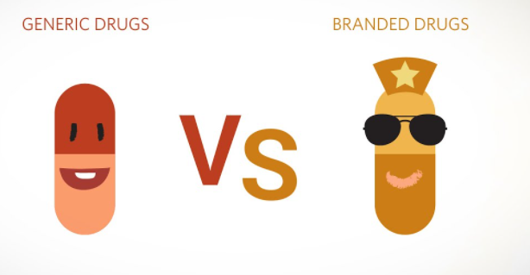
Generic product vs branded products

Slide 33
Software Application Domains
Seven broad categories of computer software present continuing challenges for software engineers:
Application Software
Software System
Engineering/scientific software
Embedded software
Product-line software
Web applications
Artificial intelligence software

Slide 34
System Software
System Software is a set of programs that control and manage the operations of computer hardware. It also helps application programs to execute correctly.
System Software are designed to control the operation and extend the processing functionalities of a computer system.
System software makes the operation of a computer more fast, effective, and secure.
Example: Operating system, programming language, Communication software, et

Slide 35
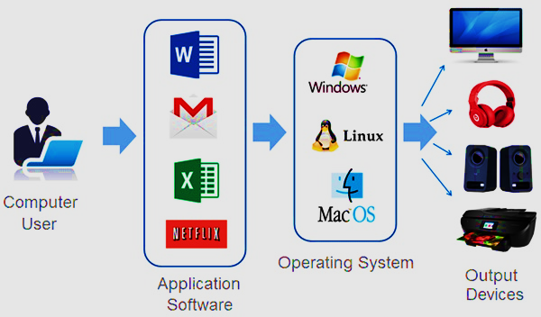
Application Software
Application Software is a program that does real work for the user. It is mostly created to perform a specific task for a user.
Application Software acts as a mediator between the end-user and System Software. It is also known as an application package.

Slide 36
Class 03 11-feb-2021

Slide 37
Key Phases of SE
Engineering discipline
Engineers make things work. They apply theories, methods, and tools where these are appropriate. However, they use them selectively and always try to discover solutions to problems even when there are no applicable theories and methods. Engineers also recognize that they must work within organizational and financial constraints, and they must look for solutions within these constraints.
All aspects of software production
Software engineering is not just concerned with the technical processes of software development. It also includes activities such as software project management and the development of tools, methods, and theories to support software development.

Slide 38



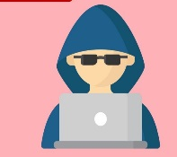
Ethics of software Engineering
Competence
Confidentiality
Intellectual property rights
Computer misuse

Slide 39
Essential attributes of good software
Efficiency
Software should not make wasteful use of system resources such as memory and processor cycles. Efficiency therefore includes responsiveness, processing time, resource utilization, etc.
Maintainability
Software should be written in such a way that it can evolve to meet the changing needs of customers. This is a critical attribute because software change is an inevitable requirement of a changing business environment.

Slide 40
Essential attributes of good software
Acceptability
Software must be acceptable to the type of users for which it is designed. This means that it must be understandable, usable, and compatible with other systems that they use.
Dependability and security
Software dependability includes a range of characteristics including reliability, security, and safety. Dependable software should not cause physical or economic damage in the event of system failure. Software has to be secure so that malicious users cannot access or damage the system.

Slide 41
Importance of SE
More and more, individuals and society rely on advanced software systems. We need to be able to produce reliable and trustworthy systems economically and quickly.
It is usually cheaper, in the long run, to use software engineering methods and techniques for professional software systems rather than just write programs a personal programming project.

Slide 42




Issues that affect many different types of software
Heterogeneity
Systems are increasingly essential to operate as distributed systems across networks, which include various types of computers and mobile devices.
Business and social change
Security
We must ensure that unauthorized users are unable to target our applications, and that information is protected and secured.
Scale
business and society are evolving extremely rapidly. They need to be in a position to update their current software and create new software quickly.
The software must be built over a broad range of scales, from very tiny embedded systems in portable or wearable devices through the Internet sizes, a cloud-based framework that serves global population

Slide 43
Software engineering diversity
Stand-alone applications
Interactive transaction-based applications
Embedded control systems
Batch processing systems
Entertainment systems
Systems for modeling and simulation
Data collection and analysis systems
Systems of systems
phones, or tablets.
games
manage hardware devices
process data in large batches
Big data
interacting objects
run on a personal computer
ERP system

Slide 44
Case Studies
An embedded system
This is a system where the software controls some hardware device and is embedded in that device.
Issues in embedded systems typically include physical size, responsiveness, and power management, etc.
The example of an embedded system that I use is a software system to control an insulin pump for people who have diabetes.

Slide 45
An insulin pump control system
An insulin pump is a medical system that simulates the operation of the pancreas (an internal organ). The software controlling this system is an embedded system that collects information from a sensor and controls a pump that delivers a controlled dose of insulin to a user.
The problem is that the level of insulin required does not just depend on the blood glucose level but also on the time of the last insulin injection

Slide 46
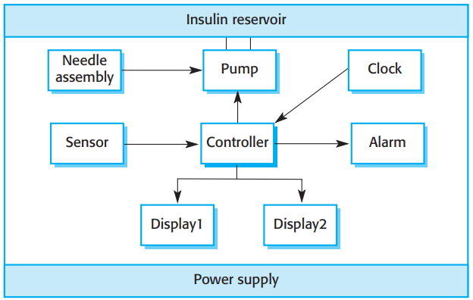
Insulin pump hardware architecture
hardware components and organization of the insulin pump

Slide 47
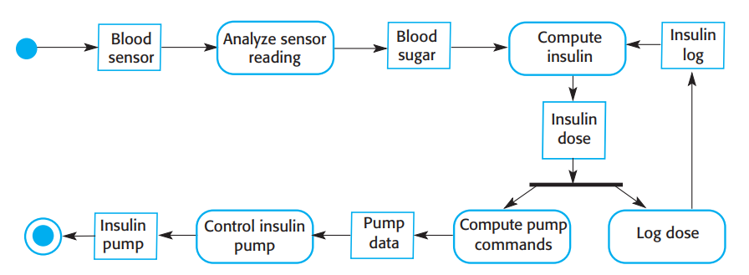
Activity model of the insulin pump
activity model that illustrates how the software transforms an input blood sugar level to a sequence of commands that drive the insulin pump.

Slide 48
Analyze
Clearly, this is a safety-critical system. If the pump fails to operate or does not operate correctly, then the user’s health may be damaged or they may fall into a coma because their blood sugar levels are too high or too low. This system must therefore meet two essential high-level requirements:
1. The system shall be available to deliver insulin when required.
2. The system shall perform reliably and deliver the correct amount of insulin to counteract the current level of blood sugar.
The system must therefore be designed and implemented to ensure that it always meets these requirements.

Slide 49
Activity- Read the case study
An information system (medical records system)
A sensor-based data collection system (a wilderness weather station)
A support environment (support students’ learning in schools)

Slide 50
THANK-YOU

